Slide 1
CH & J
tʃ & dʒ
-tu-

Slide 2
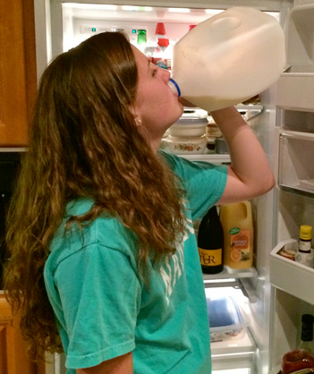
I want to chug a jug of milk

Slide 3
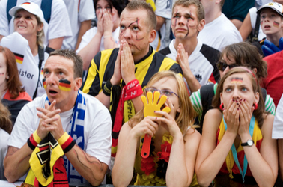
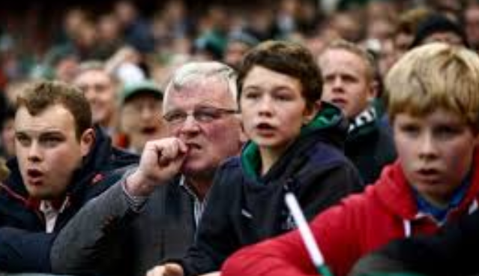
I was in the edge of my seat watching each match of the major tournament

Slide 4
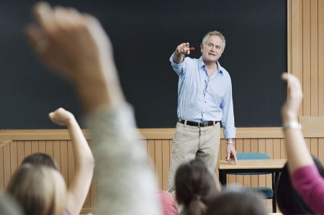
The mature lecturer pictured this century’s adventure literature

Slide 5
Job | /jäb/ | Adjective | /ˈajəktiv/ | Soldier | /ˈsōljər/
Jar | /jär/ | Object | /ˈäbjəkt/ | Page | /pāj/
June | /jo͞on/ | Project | /ˈpräjˌekt/ | Stranger | /ˈstrānjər/
Jail | /jāl/ | Injury | /ˈinj(ə)rē/ | Giant | /ˈjīənt/
Just | jəst | Major | /ˈmājər/ | Bridge | /brij/
Juice | jo͞os | Enjoy | /enˈjoi/ | Edge | /ej/
Joke | /jōk/ | Jewish | /ˈjo͞oiSH/ | Charge | /CHärj/
Jam | /jam/ | Imagine | /iˈmajən/ | Budget | /ˈbəjət/
Justice | /ˈjəstəs/ | Manager | /ˈmanijər/ | Judge | /jəj/
Jump | /jəmp/ | Exaggerate | /iɡˈzajəˌrāt/ | Package | /ˈpakij/

Slide 6
Chubby | /ˈCHəbē/ | Adventure | /adˈven(t)SHər/ | Challenge | /ˈChalənj/
Choke | /CHōk/ | Peach | /pēCH/ | Cherry | /ˈCherē/
Witch | wiCH | Beach | /bēCH/ | Achievement | /əˈCHēvmənt/
Picture | /ˈpik(t)SHər/ | Culture | /ˈkəlCHər/ | Attach | /əˈtaCH/
Chair | /Cher/ | Preach | /prēCH/ | Childish | /ˈCHīldiSH/
Choose | /CHo͞oz/ | Virtue | /ˈvərCHo͞o/ | Chilly | /ˈChilē/
Chocolate | /ˈCHäk(ə)lət/ | Speech | /spēCH/ | Exchange | /iksˈCHānj//
Lecture | /ˈlek(t)SHər/ | Touch | /təCH/ | Fortune | /ˈfôrCHən/
Charmed | /CHärmd/ | Actually | /ˈak(t)SH(əw)əlē/ | Cockroach | /ˈkäkˌrōCH/
Chump | /CHəmp/ | Which | /(h)wiCH/ | Sandwich | /ˈsanˌ(d)wiCH/

Slide 7
Chubby | /ˈCHəbē/ | Lecture | /ˈlek(t)SHər/ | Soldier | /ˈsōljər/
Joke | /jōk/ | Just | jəst | Exaggerate | /iɡˈzajəˌrāt/
Choke | /CHōk/ | Actually | /ˈak(t)SH(əw)əlē/ | Injury | /ˈinj(ə)rē/
Fortune | /ˈfôrCHən/ | Major | /ˈmājər/ | Virtue | /ˈvərCHo͞o/
Soldier | /ˈsōljər/ | Project | /ˈpräjˌekt/ | Object | /ˈäbjəkt/
Choose | /CHo͞oz/ | Virtue | /ˈvərCHo͞o/ | Chunk | /CHəNGk/
Major | /ˈmājər/ | Exchange | /iksˈCHānj/ | Touch | /təCH/
Jewish | /ˈjo͞oiSH/ | Bridge | /brij/ | Budget | /ˈbəjət/
Jump | /jəmp/ | Giant | /ˈjīənt/ | June | /jo͞on/
Chump | /CHəmp/ | Enjoy | /enˈjoi/ | Edge | /ej/

Slide 8
1. Two twisted witches watched two wrist watches. If two witches watched two wrist watches, which witch would watch which watch? 2. A cheap sheep is cheaper than a cheap ship. 3. Jackie's jumping jovially 'round Jakarta. 4. Chubby jugglers juggling oranges jovially. 5. A gentle judge judges justly. 6. Chester's sisters stitched Chester's vests.

